Slide 1

Modeling an adaptive learning rate
The Pearce-Hall model
Jack Gabel, Sol Markman, Quilee Simeon, and Hokyung Sung

Slide 2
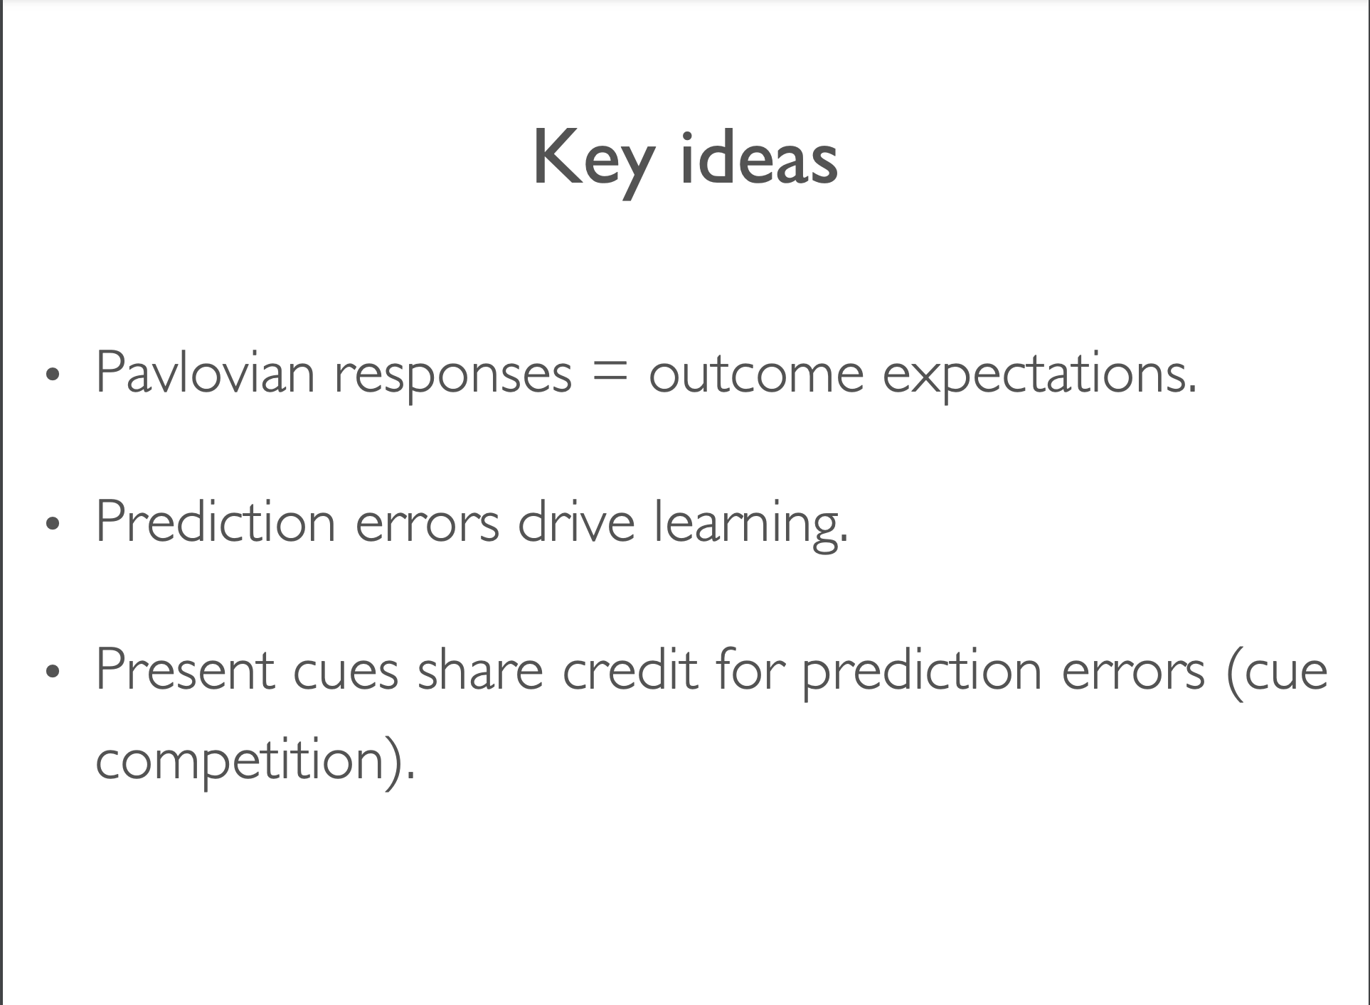
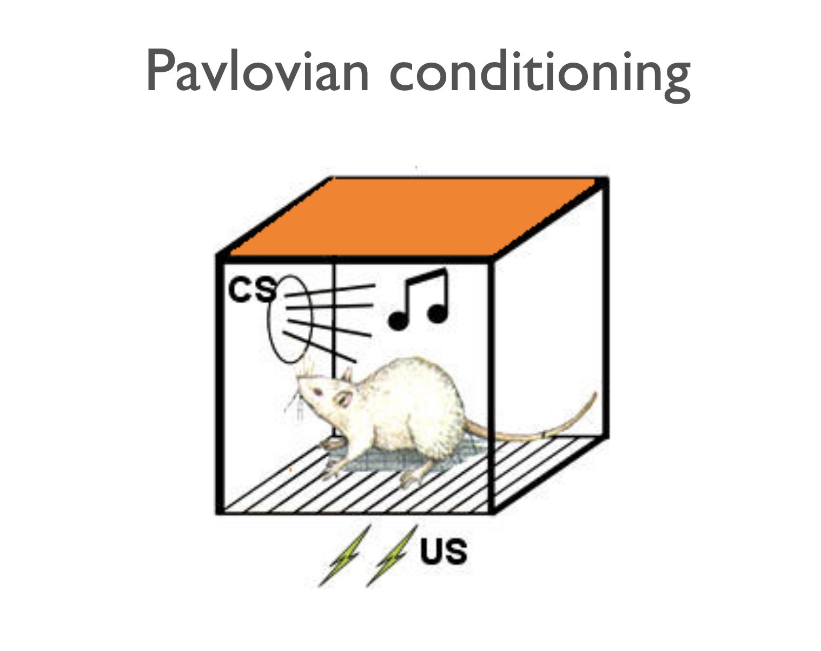

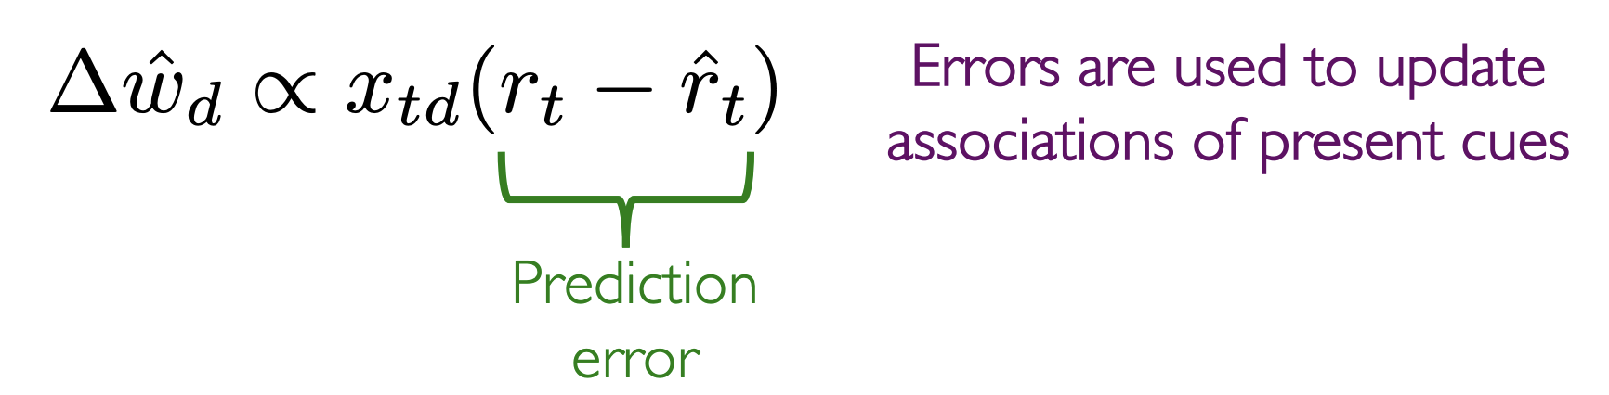
Background and Motivation
https://twitter.com/catshouldnt/status/1706125291104669829

Slide 3



Background and Motivation
But the real world is much more complex…
e.g. the PhD Simulator :o https://research.wmz.ninja/projects/phd/index.html
> If the environment is volatile (e.g. stock market), you might want to update your model more quickly given errors

Slide 4
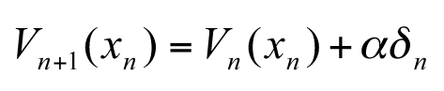
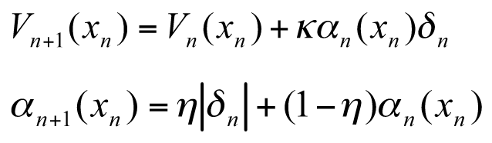
Introducing an adaptive learning rate
Rescorla-Wagner
+ variable learning rate
Pearce-Hall
Learning rate increases when the value is less predictable
Notes:
In the paper, alpha is called “associability.” It drives changes in the learning rate (kappa*alpha).
Eta controls how much the learning rate updates on each trial (eta=0 constant learning rate).
abs(PE) = “surprise”: learning rate increases when the value is less predictable

Slide 5
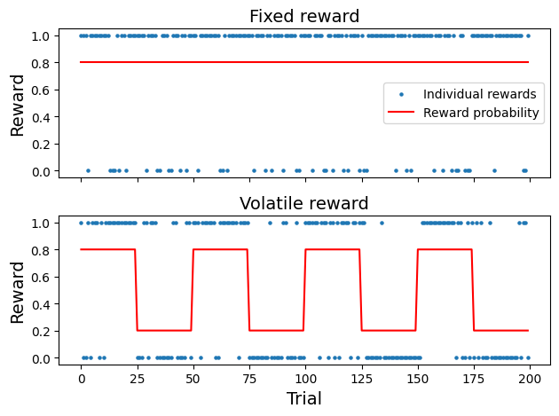
Learning rate and reward volatility
P(reward) = 0.8
P(reward) =
0.8, 0.2, 0.8, …

Slide 6
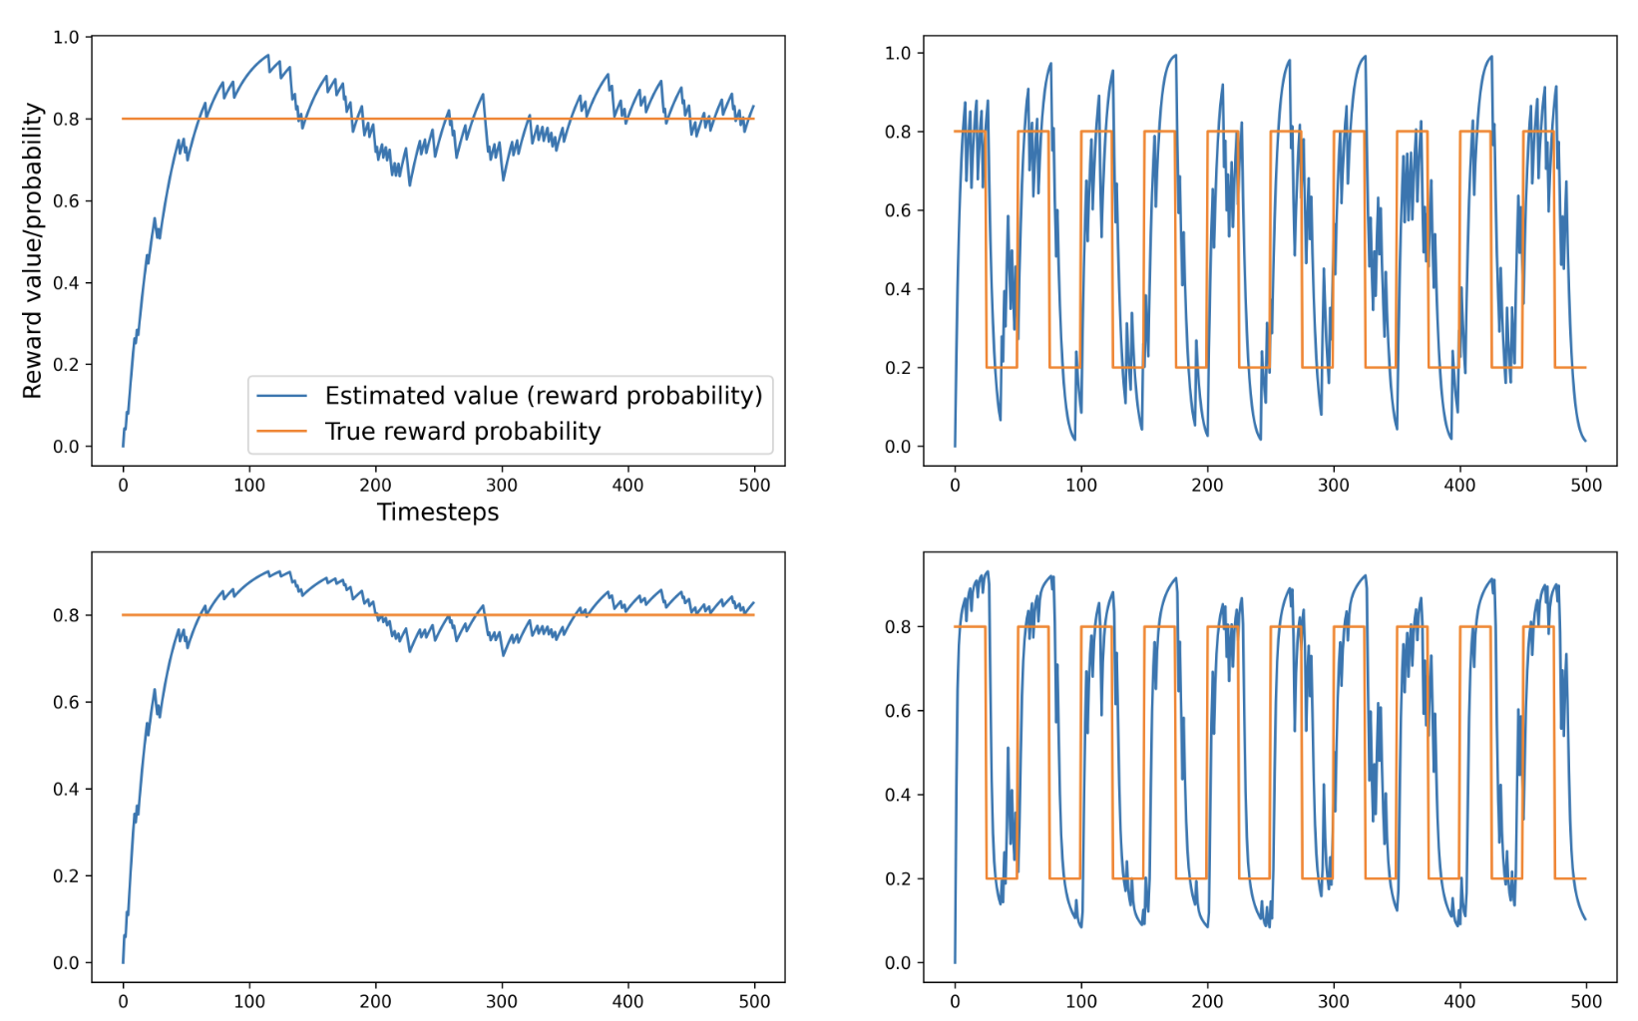
Stable
Volatile
Rescorla-Wagner
⍺_stable = 0.04
Error: 0.07
⍺_vol = 0.23
Error: 0.17
Pearce-Hall
η_stable = 0.03
Error: 0.05
η_vol = 0.68
Error: 0.16

Slide 7
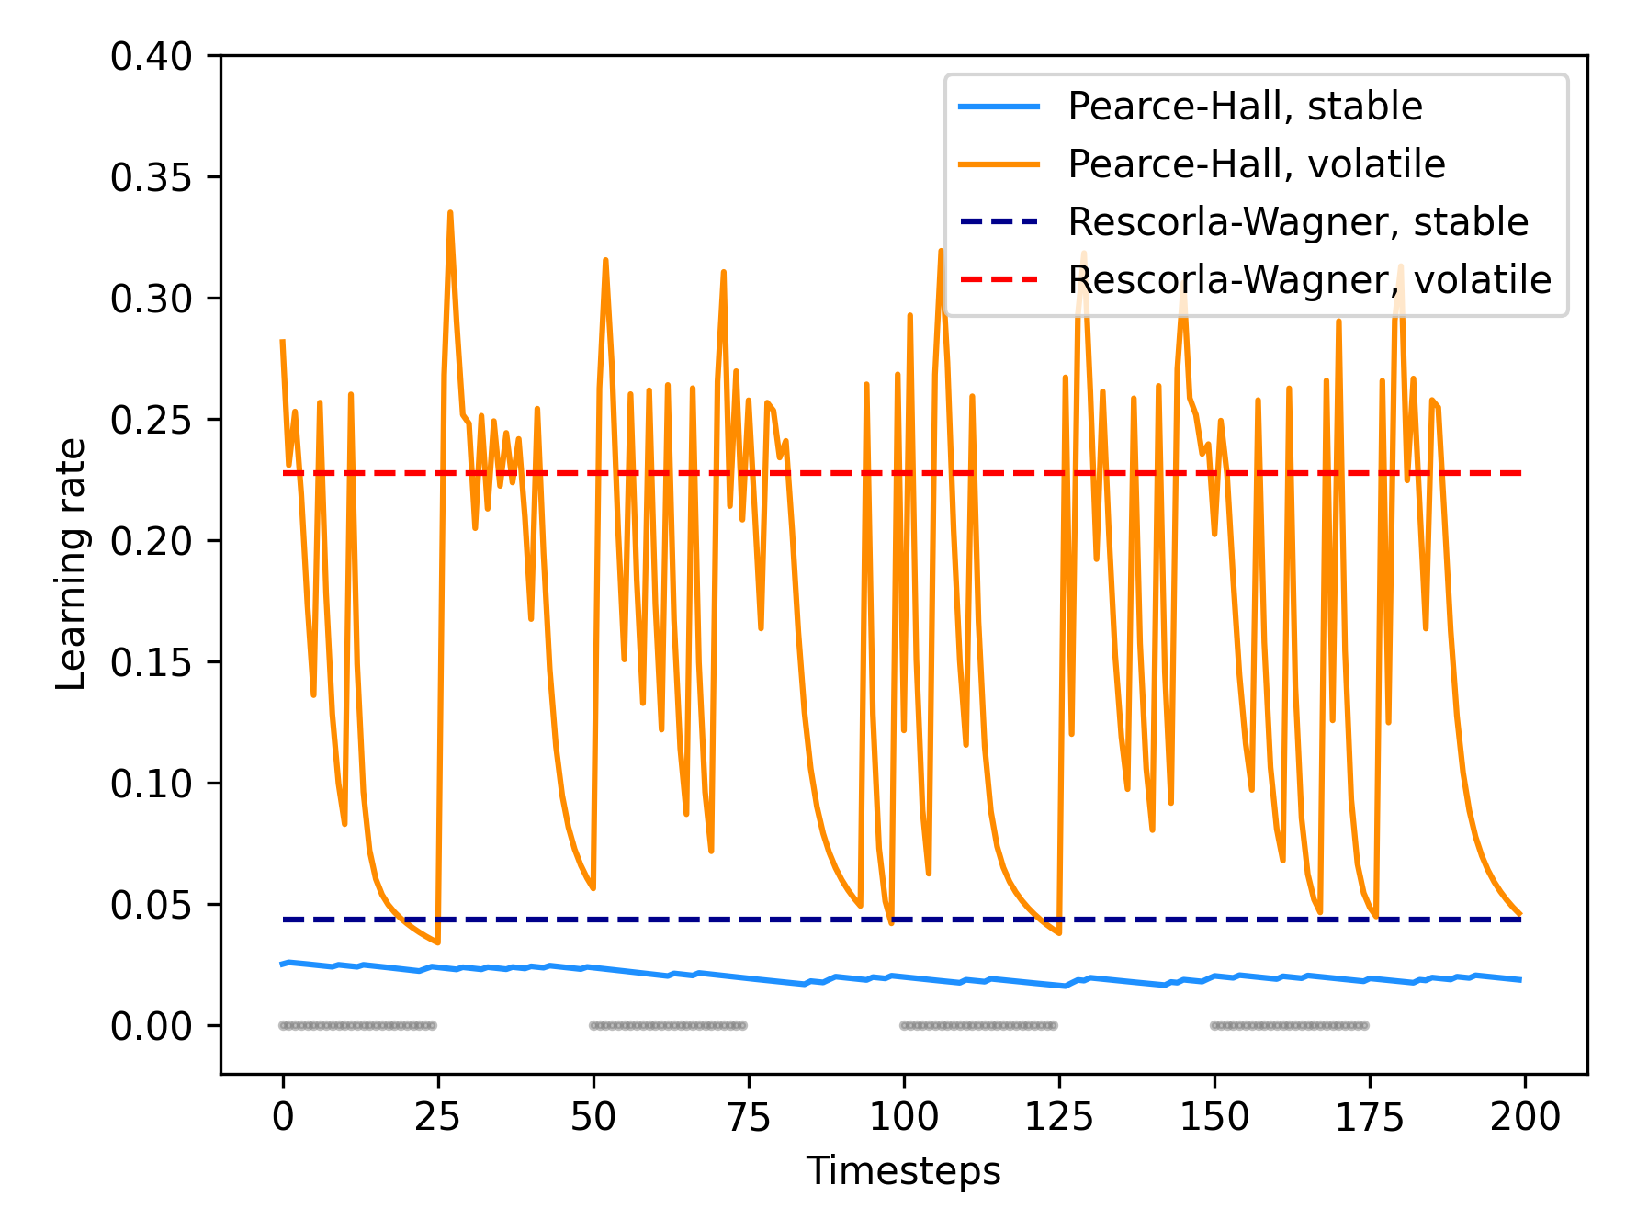
Learning rate is higher for more volatile environments

Slide 8
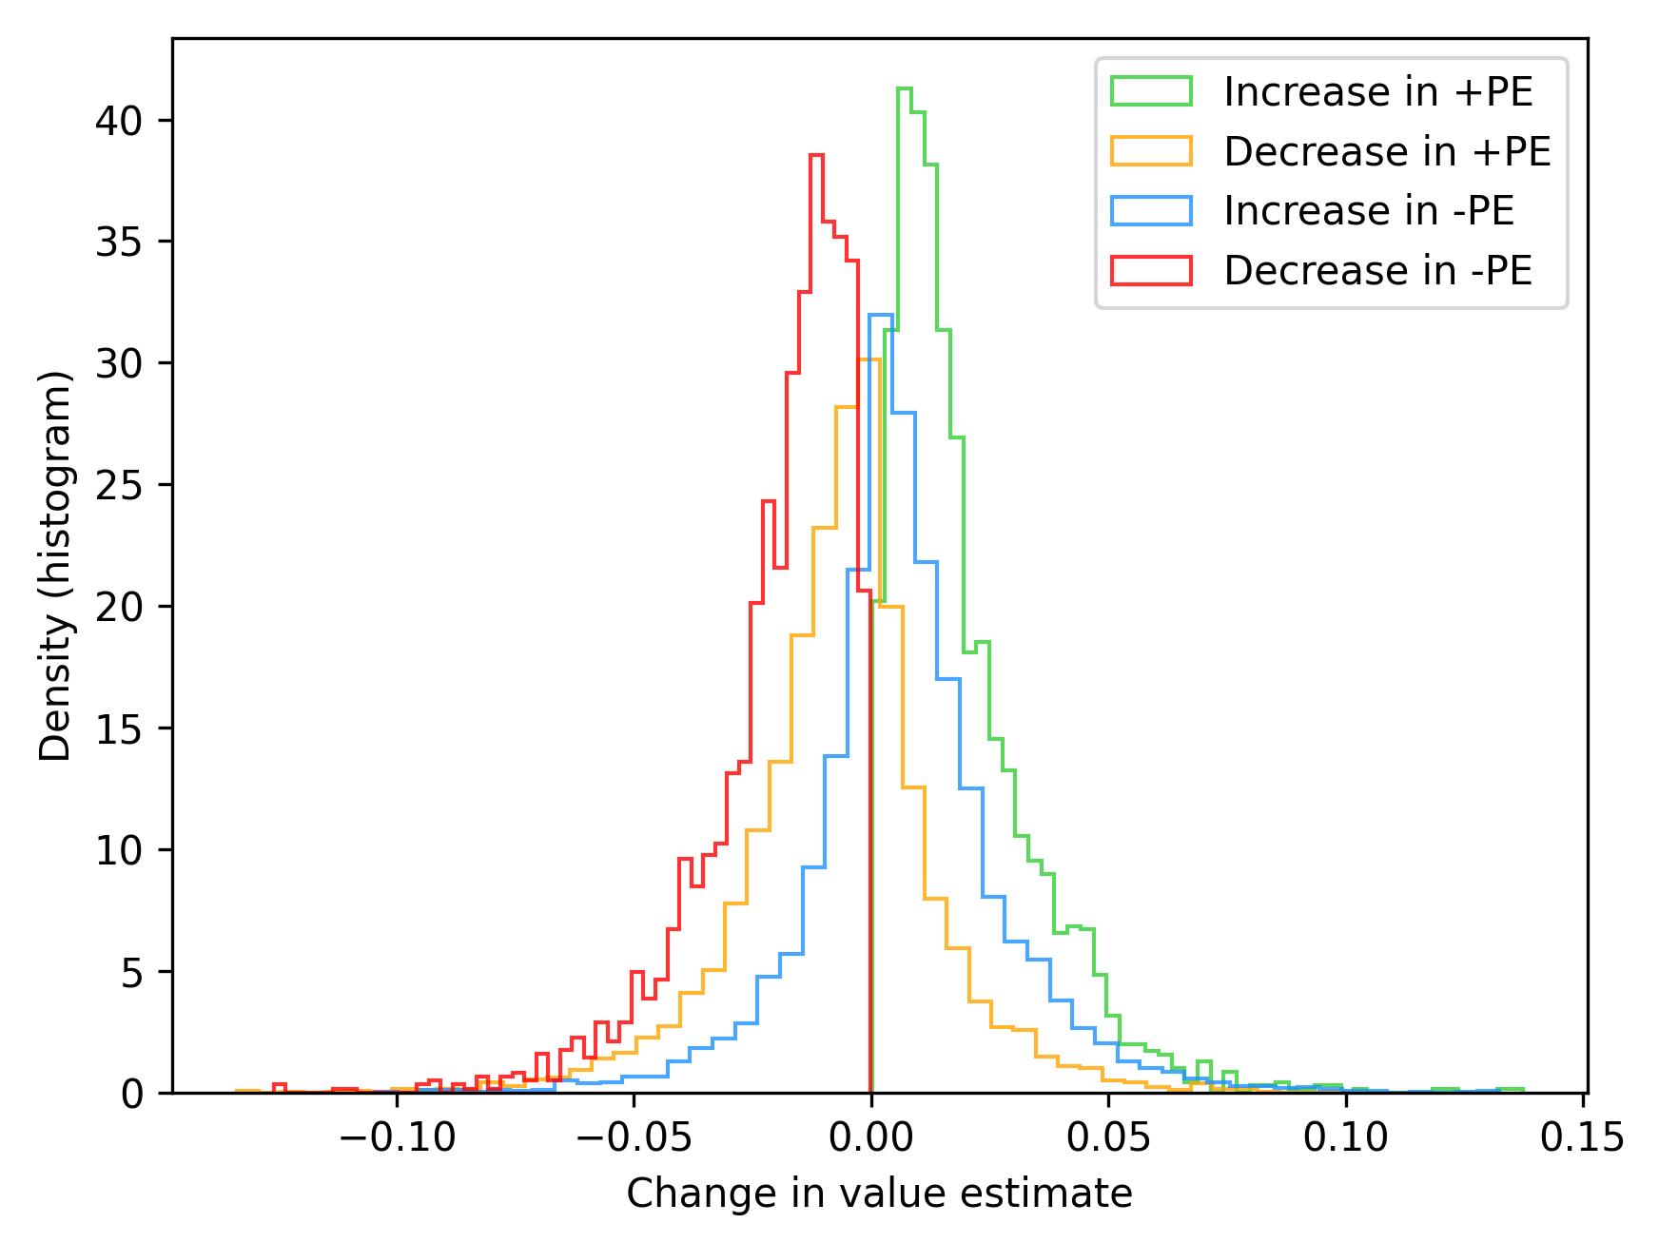
Effects of changes in prediction errors on value
Notes:
Symmetry matters for changes in value

Slide 9
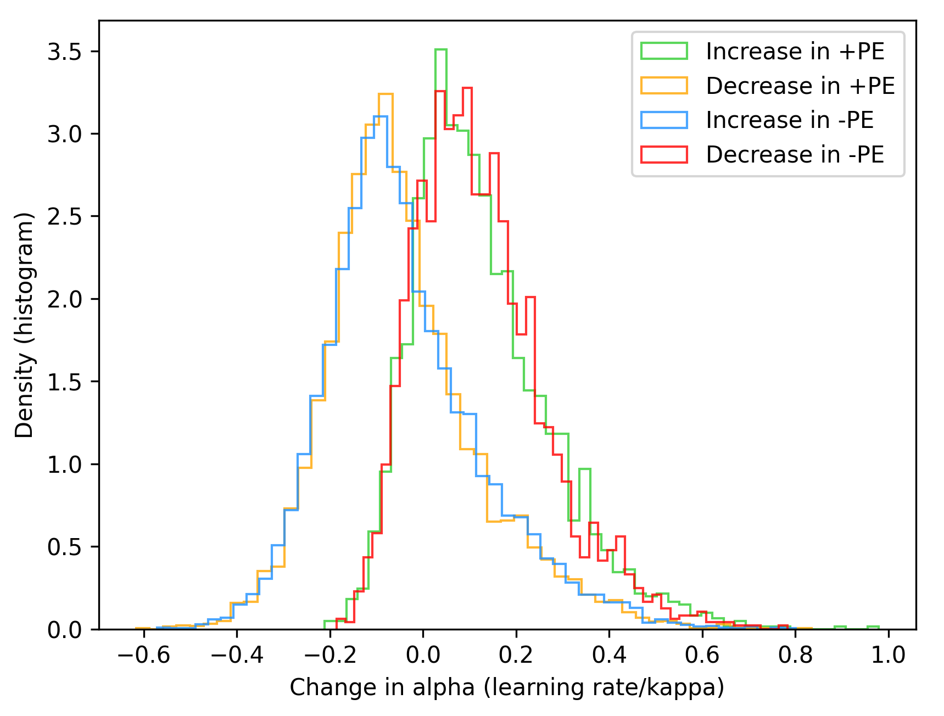
Effects of changes in prediction errors on learning rate
Notes:
Only magnitude of prediction error matters. Sign doesnt matter

Slide 10
Distinguishing Learning Rate and Value Experimentally
Behavior and model fitting
Neural recording from amygdala (learning rate) or OFC (value)
Dopamine agonists or antagonists to affect learning rate
Lever A
Lever B
Fixed small rewards
Variable rewards

Slide 11
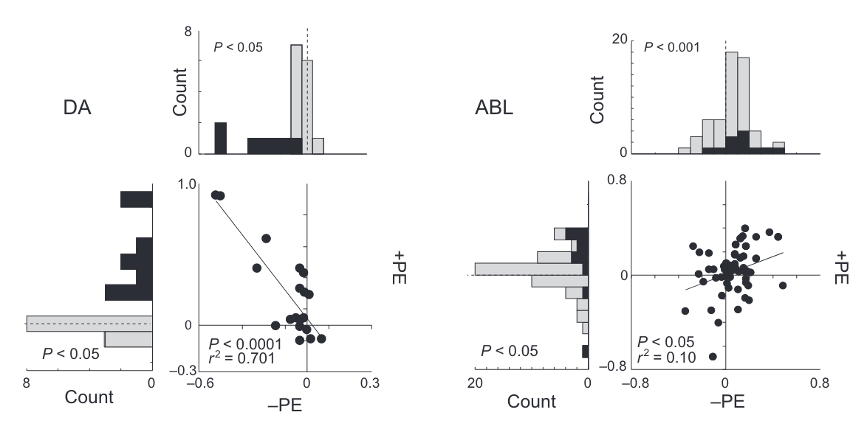
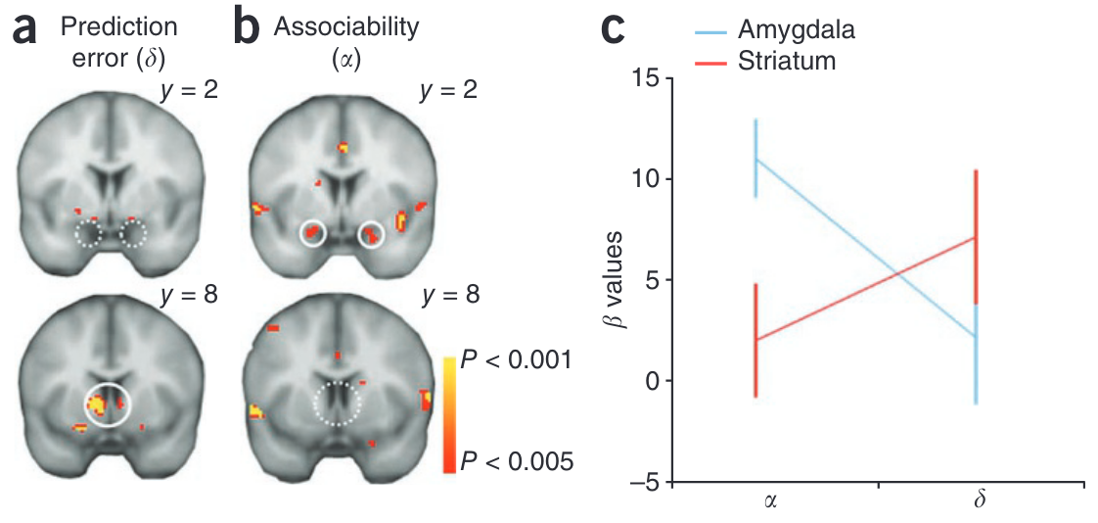
Where is the adaptive learning rate in the brain?
Unsigned reward prediction errors in basolateral-amygdala (ABL) system (Roesch et al. 2010)
Amygdala BOLD responses track associability (Li et al. 2011)
Notes:
unsigned prediction errors
Signed prediction errors

Slide 12
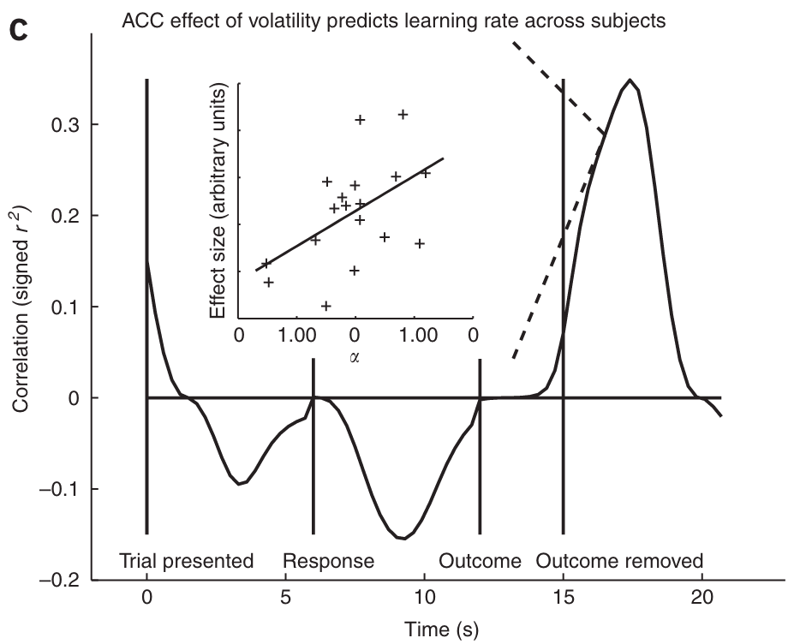
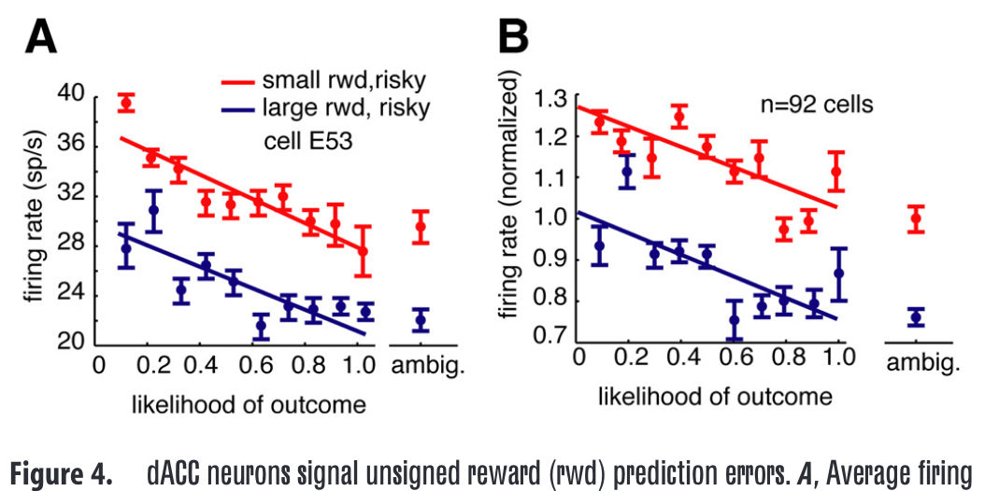
Where might learning rate be computed in the brain?
Unsigned reward prediction errors in the ACC (Hayden et al. 2011)
Tracking volatility in ACC explains learning rate (Behrens et al. 2007)
Notes:
unsigned prediction errors
Signed prediction errors

Slide 13
Discussion Questions
Are there any other tasks (besides the one mentioned) that might help experimentally distinguish learning rate from value through behavior?
If the environment is very noisy, but the noise is unstructured, should the learning rate still be higher? Why or why not?
What are potential neural mechanisms by which higher associability might lead to faster learning?
Notes:
unsigned prediction errors
Signed prediction errors

Slide 14
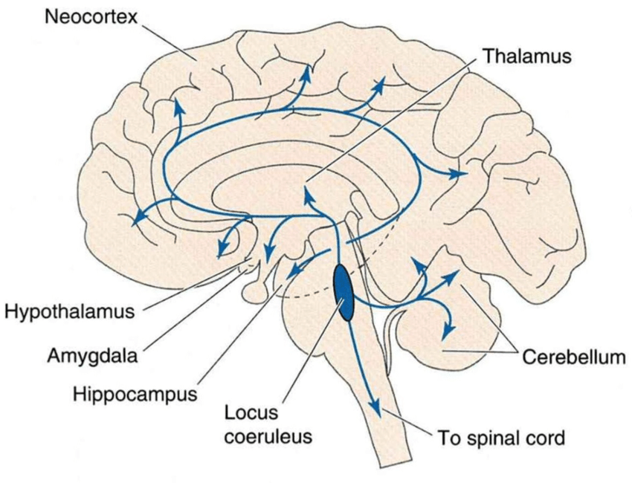

A potential circuit mechanism for adaptive learning rate
Locus Coeruleus (LC-NA system)
Principal site for synthesis of norepinephrine
Norepinephrine increases arousal and alertness, promotes vigilance, enhances formation and retrieval of memory, and focuses attention
Known that ACC has bidirectional projections and is the main cortical input to LC
High (unsigned) RPE -> ACC activation -> LC -> attention!
Notes:
unsigned prediction errors
Signed prediction errors

Slide 15
References
Behrens, T.E., Woolrich, M.W., Walton, M.E. & Rushworth, M.F. (2007) Learning the value of information in an uncertain world. Nature Neuroscience, 10, 1214–1221.
Li, J., Schiller, D., Schoenbaum, G., Phelps, E.A., & Daw, N.D. (2011). Differential roles of human striatum and amygdala in associative learning. Nature Neuroscience, 14, 1250–1252.
Roesch, M.R., Esber, G.R., Li, J., Daw, N.D., and Schoenbaum, G. (2012). Surprise! Neural correlates of Pearce-Hall and Rescorla-Wagner coexist within the brain. European Journal of Neuroscience, 35, 1190–1200.

Slide 16
Thank you!

